Slide 1


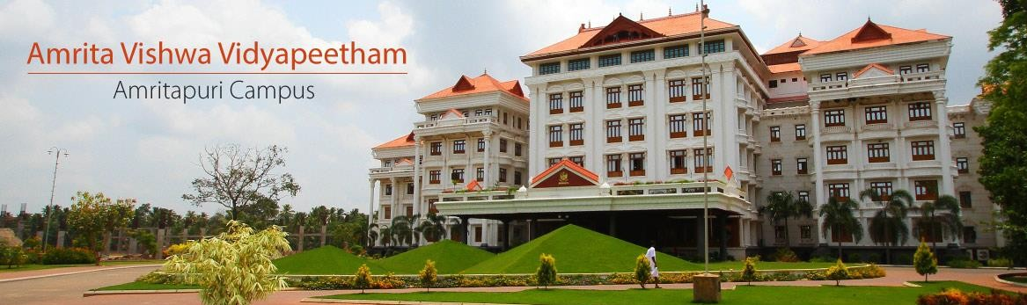
22AIE204 Introduction to Computer Networks 2-0-3- 3

Slide 2
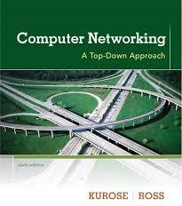

Slide 3
Lecture No(s) | Topics | Course Outcomes
Week 1 | Introduction to Computer Networks | CO1
Week 2 | Network Topologies | CO1
Week 3 | Network Core, Network Edge | CO1
Week 4 | Internet Protocol Stack | CO1
Week 5 | Application layer protocols -HTTP | CO1
Week 6 | Application layer protocols -DNS, FTP, SMTP | CO1
Week 7 | Transport Layer – Connection oriented and Connectionless service | CO1
Week 8 | Network layer- Internet Protocol, Network layer- IP addressing | CO2 & CO3
Week 9 | Network layer- Routing and forwarding | CO2 & CO3
Week10 | Network layer- Router Configuration | CO2 & CO3
Week 11 | Data link & Physical layer | CO1
Week 12 | IoT - components | CO3 & CO4
Week 13 | Fog computing, Cloud computing | CO4
Week 14 | Introduction to Software Define Networks | CO4

Slide 4
Evaluation Pattern
Midterm exam: 20 Marks
Continuous Assessment: 50 Marks
- Quiz (2) - 5 marks each ( 10 marks)
- Lab submission(3) - 5 marks each (15 marks)
- Mini project (max 3 per team) - (25 marks)
End Semester exam: 30 Marks

Slide 5

Chapter I:
Computer Networks and the Internet

Slide 6
Chapter -1 Introduction
1.1 What Is the Internet?
1.1.3 What Is a Protocol?
1.2 The Network Edge
1.2.1 Access Networks
1.2.2 Physical Media
1.3 The Network Core
1.3.1 Packet Switching
1.3.2 Circuit Switching
1.3.3 A Network of Networks
1.4 Delay, Loss, and Throughput in Packet-Switched Networks
1.5 Protocol Layers and Their Service Models
1.5.1 Layered Architecture
1.5.2 Encapsulation

Slide 7
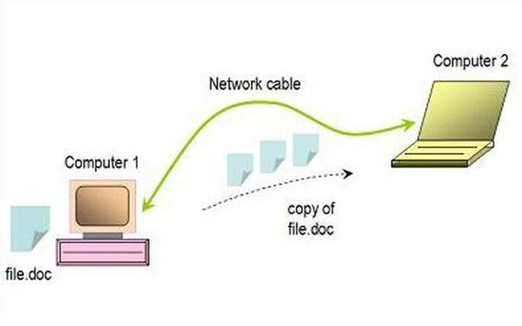
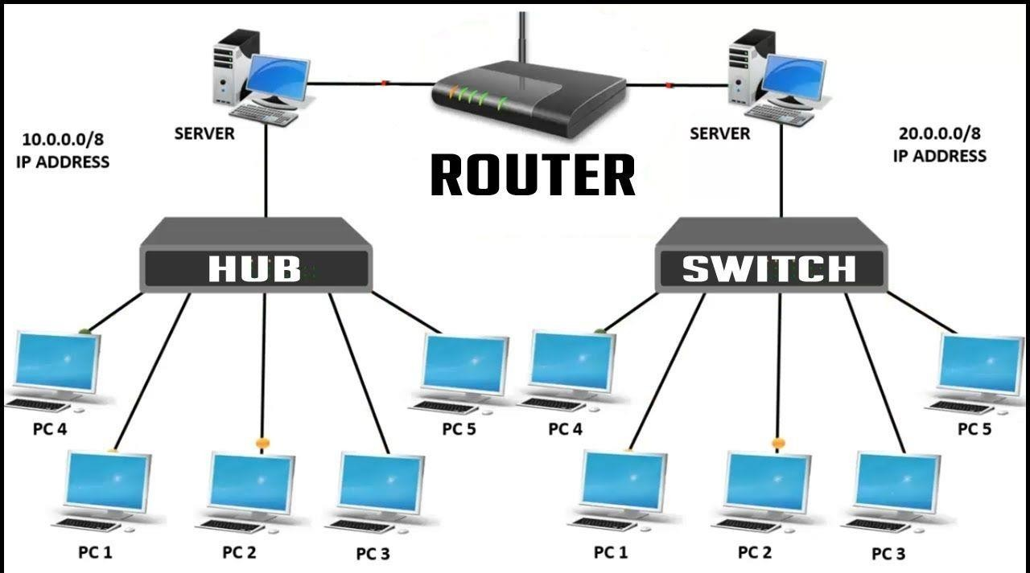
What is a computer Network
A computer network is a set of computers that are connected together so that they can share information .Computer networks are the basis of communication in IT. They are used in a huge variety of ways and can include many different types of network..
Some of the things that networks are used for include:
Communicating using email, video, instant messaging and other methods
Sharing devices such as printers, scanners and photocopiers
Sharing files
Sharing software and operating programs on remote systems
Allowing network users to easily access and maintain information

Slide 8
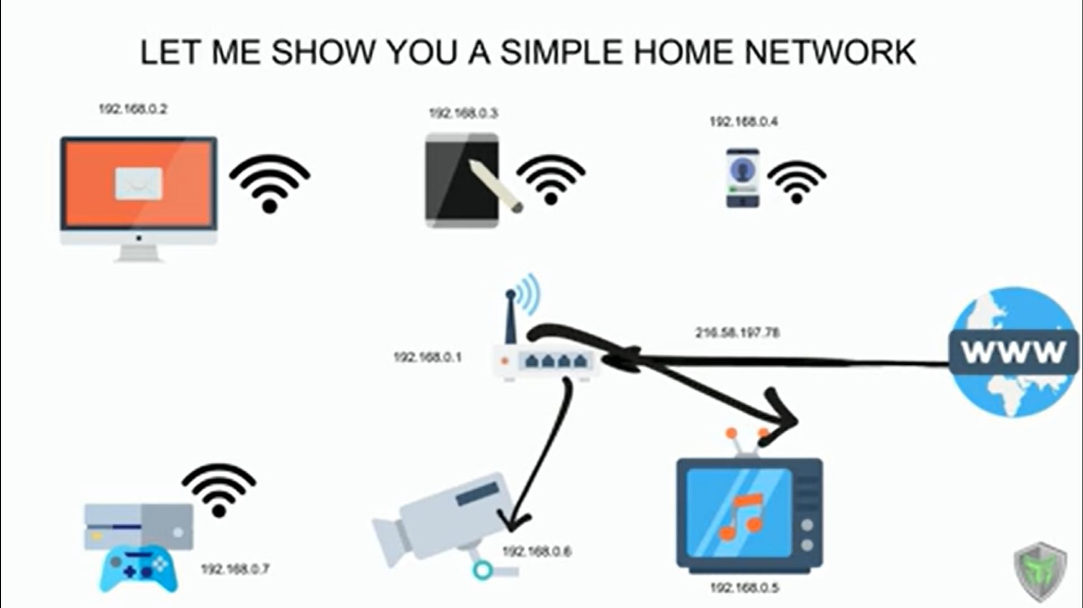

Slide 9


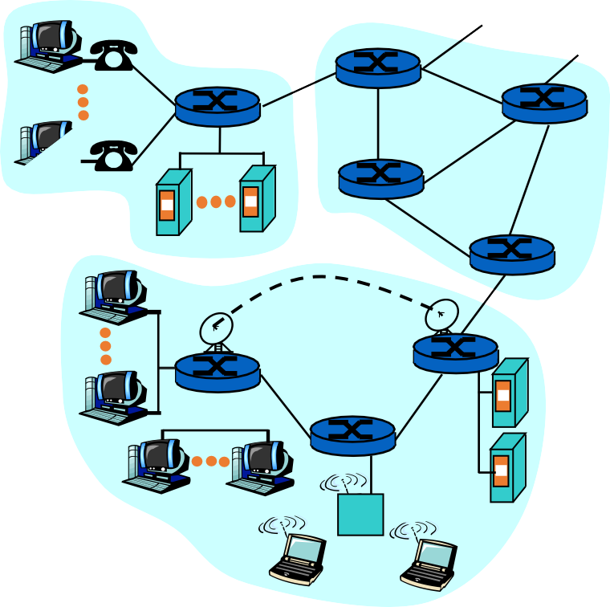
What is a Computer Network?
A set of communication elements connected by communication links
➭ Communication elements
Computers, printers, mobile phones, …
Routers, switches, ...
➭ Communication links
optic fiber
coaxial cable
twisted pair
wireless (radio, microwave, satellite)
router
workstation
mobile
server
local ISP
regional ISP
➭ Topologies
Ring, Star, Bus, Tree, Mesh
company network

Slide 10

Introduction
Computer Network
an interconnected collection of autonomous computers
Internet: “network of networks”
loosely hierarchical
public Internet versus private Intranet
WWW a distributed systems run on the top of Internet
Distributed System
High degree of cohesiveness and transparency
A software system built on top of a network
11

Slide 11
Internetworks
Internetworks connect networks with different hardware and software
A collection of interconnected networks is called an internetwork or internet
Gateways are used to make the connection and to provide the necessary translation (protocol conversion)
A gateway is a node (router) in a computer network, a key stopping point for data on its way to or from other networks.
... For basic Internet connections at home, the gateway is the Internet Service Provider that gives you access to the
entire Internet.
12

Slide 12
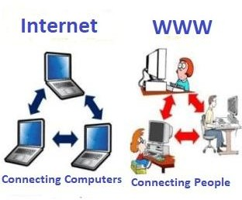
Internet : WWW
World Wide Web, ( Web), is a large distributed system, a collection of websites or web pages stored in web servers and connected to local computers through the internet.
Internet is the network of connected computers that the web works on, as well as what emails and files travel across.
Think of the internet as the roads that connect towns and cities together. The world wide web contains the things you see on
the roads like houses and shops

Slide 13
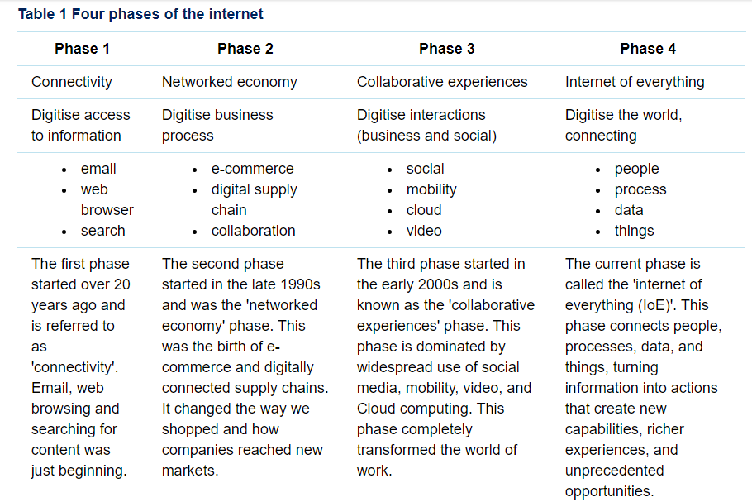
Evolution of Internet

Slide 14
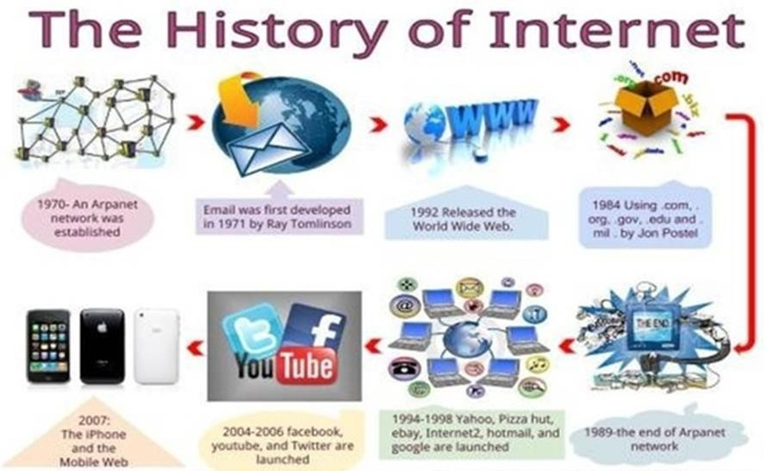
History of Internet
The first workable prototype of
the Internet came in the late 1960s with the creation of ARPANET, or the Advanced Research Projects Agency Network.
Originally funded by the U.S. Department of Defense, ARPANET used packet switching to allow multiple computers to communicate on a single network.

Slide 15


































Internet – its component
mobile network
Multiple ISPs together form
the Internet
Global, regional ISPs, residential ISPs, home network, enterprise network
Hosts, servers, Network core, switches, routers
global ISP
home
network
regional ISP
institutional
network
J. Kurose and K. Ross 2012, Computer Network,6th ed.

Slide 16




















Internet – its component
protocols control sending, receiving of msgs
e.g., TCP, IP, HTTP,
Skype, 802.11
Internet standards
RFC: Request for comments
IETF: Internet Engineering Task Force
mobile network
global ISP
home
network
regional ISP
Physical media
Copper wire, optical
fiber,
institutional
network
The IETF is a large open international community of network designers, operators, vendors, and researcher who make the Internet
work better by producing high quality, relevant technical documents that influence the way people design, use, and manage the Internet.

Slide 17





